Slide 1
Raw House Data Analysis
By Ram Sunder on March 24, 2025

Slide 2
Table of Content
Overview
Libraries used for EDA
Understanding Colums
Potential Issues to Address
Final Classification
Challenges(Future Warning)
Data Visualization
Summary
Question and Answers

Slide 3
Overview
Initial Observations from the Dataset
Total Records: 5,000 rows
Columns: 16
Data Types:
Numerical: MLS, sold_price, zipcode, longitude, latitude, lot_acres, taxes, year_built, bedrooms, fireplaces,bathrooms,garage,sqrt_ft
Categorical (Objects): kitchen_features, floor_covering, HOA
Missing Values:
lot_acres (10 missing)
fireplaces (25 missing)
sqrt_ft, garage, and HOA have None values (Need conversion to NaN)

Slide 4
Technology used in EDA
Google Collab
Python
Libraries
Pandas: Read, clean, and manipulate data
NumPy: Handle numerical operations
Matplotlib & Seaborn: Create plots

Slide 5
Understanding Dataset Columns
Column Name | Description
MLS | Listing ID
sold_price | Sale price of the house
zipcode | Location identifier
longitude/latitude | Geographic location
lot_acres | Land area in acres
taxes | Annual property tax
year_built | Year house was built
bedrooms | Number of bedrooms
bathrooms | Number of bathrooms
Column Name | Description
sqrt_ft | Total square footage
garage | Number of garage spaces
kitchen_features | Kitchen specifications
fireplaces | Number of fireplaces
floor_covering | Type of flooring
HOA | Homeowners Association fee

Slide 6
Potential Issues to Address
Bathrooms, Square Footage (sqrt_ft), and Garage columns are objects
Convert them to appropriate numerical types.
Missing Values Handling
lot_acres and fireplaces can be imputed or removed.
HOA contains None, which might indicate missing values
Need to check whether None means "No HOA" or a missing value.
Kitchen Features and Floor Covering are categorical
Need to encode or analyze further.

Slide 7
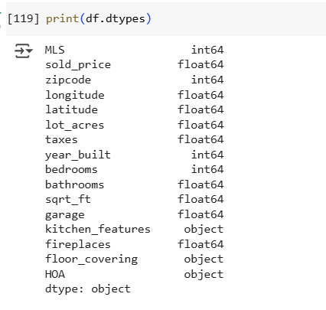
Potential Issues to Address
Missing Values Summary:
lot_acres → 10 missing
bathrooms → 6 missing
sqrt_ft → 56 missing
garage → 7 missing
fireplaces → 25 missing
HOA → 580 missing (possibly because many properties don't have HOA fees)

Slide 8
Potential Issues to Address
Handle missing values:
lot_acres, bathrooms, sqrt_ft, garage, and fireplaces → Fill with median or mode.
HOA → Treat missing values as zero (if None means no HOA).

Slide 9
Final Classification
Numerical (Continuous & Discrete)
sold_price, longitude, latitude, lot_acres, taxes, year_built, bedrooms, fireplaces, bathrooms, sqrt_ft, garage, HOA
Categorical
kitchen_features, floor_covering
Drop / Ignore
MLS (just an ID, not useful for predictions)

Slide 10
Pandas/Seaborn Future Warning Fix
Instead of: df['lot_acres'].fillna(df['lot_acres'].median(), inplace=True)
Use: df['lot_acres'] = df['lot_acres'].fillna(df['lot_acres'].median())
Instead of: sns.kdeplot(df['sold_price'], shade= True, color= 'green')
Use: sns.kdeplot(df['sold_price'], shade= True, color= 'green')

Slide 11
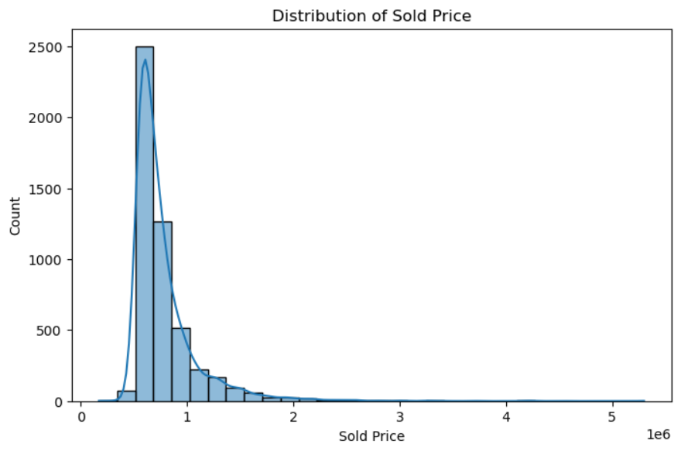
Histogram (Frequency Plot)
Used for: Checking the distribution of a numerical variable.
The X-axis: Value of the variable (e.g., sold_price).
The Y-axis: Count (frequency) of how many times a value appears.
Explanation
sns.histplot() → Creates a histogram.
bins=30 → Divides the data into 30 bins (smaller bins mean lower counts).
kde=True → Adds a smooth curve (Kernel Density Estimation) to show distribution shape.
📌 Example: If sold_price values range from 100K to 1M, this plot shows how many houses fall in each price range.

Slide 12
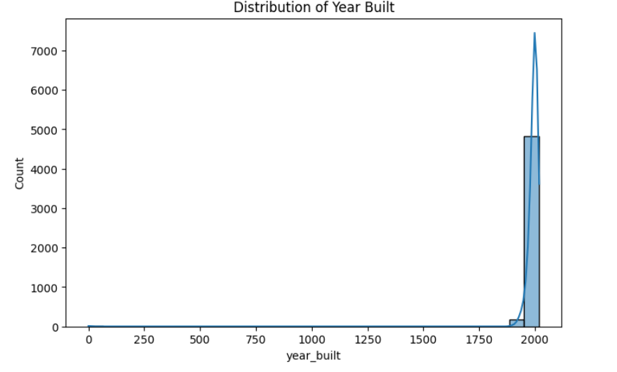

Slide 13
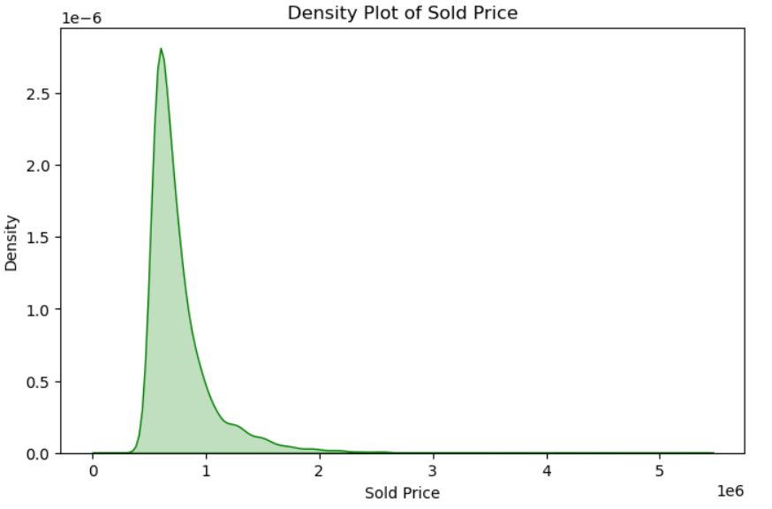
Distribution Plot
Used for: Checking if the data follows a normal distribution.
Similar to a histogram but focuses more on smooth curves.
Explanation
sns.kdeplot() → Creates a density plot.
shade=True → Fills the area under the curve.
This helps check if the data is skewed (left/right) or normally distributed.
Example: If most house prices are between 200K-500K, the curve will peak there.

Slide 14
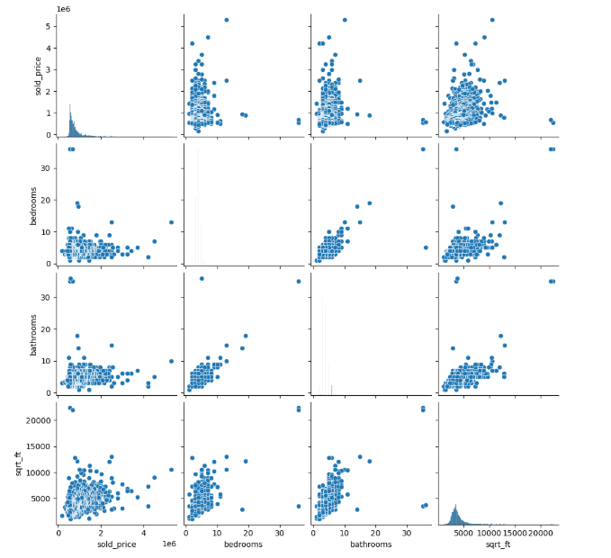
Pair Plot
Used for: Checking relationships between multiple numerical variables.
It creates scatter plots + histograms for every combination.
Explanation
sns.pairplot(df[columns]) → Plots all numerical columns.
Helps detect correlations (e.g., larger houses have higher prices?).
Example:
Sold Price vs Bedrooms → Do more bedrooms increase price?
Sold Price vs sqrt_ft → Bigger houses → Higher price?

Slide 15
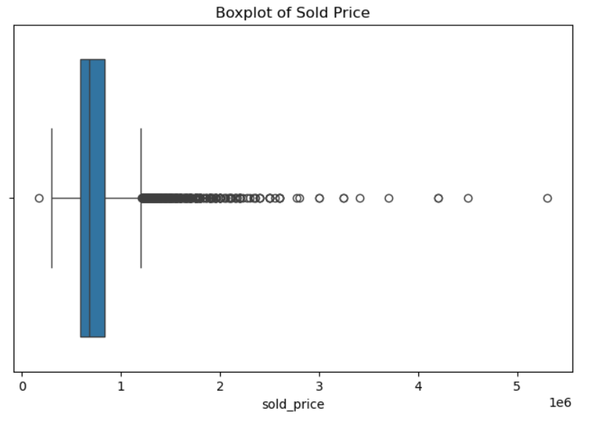
Box and Whisker Plot (Boxplot)
Used for: Identifying outliers in numerical data.
Shows median, quartiles, and extreme values.
Explanation
sns.boxplot() → Creates a box plot.
The box shows Q1 (25%), median (50%), and Q3 (75%).
Outliers appear as individual dots beyond whiskers.
Example: If most houses are under 500K, but some are 5M+,
those 5M+ values will appear as outliers.

Slide 16
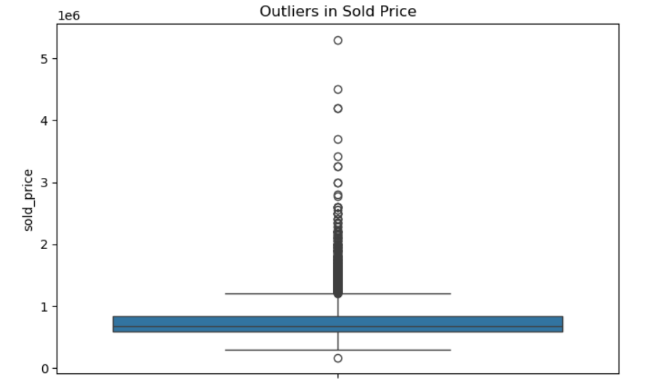
Outlier Detection with Boxplot
Used for: Identifying extreme values in specific columns.
Explanation
sns.boxplot(y=df['sold_price']) → Detects extreme price points.
Outliers = Dots beyond whiskers (data points far from median).
Example:
If 90% of house prices are below 1M, but some are 10M, those 10M houses are outliers

Slide 17
Correlation Matrix (Heatmap)
Used for: Finding relationships between numerical columns.
Shows which variables affect each other.
Explanation
df.corr() → Calculates correlation between numerical columns.
sns.heatmap() → Displays it as a color-coded matrix.
Closer to +1 → Strong positive correlation (e.g., more sqft → higher price).
Closer to -1 → Strong negative correlation.
0 means no relation.
Example:
Sold Price & Square Feet = 0.85 → Bigger houses cost more.
Sold Price & Bedrooms = 0.40 → Weak relation (more bedrooms don’t always mean higher price).

Slide 18
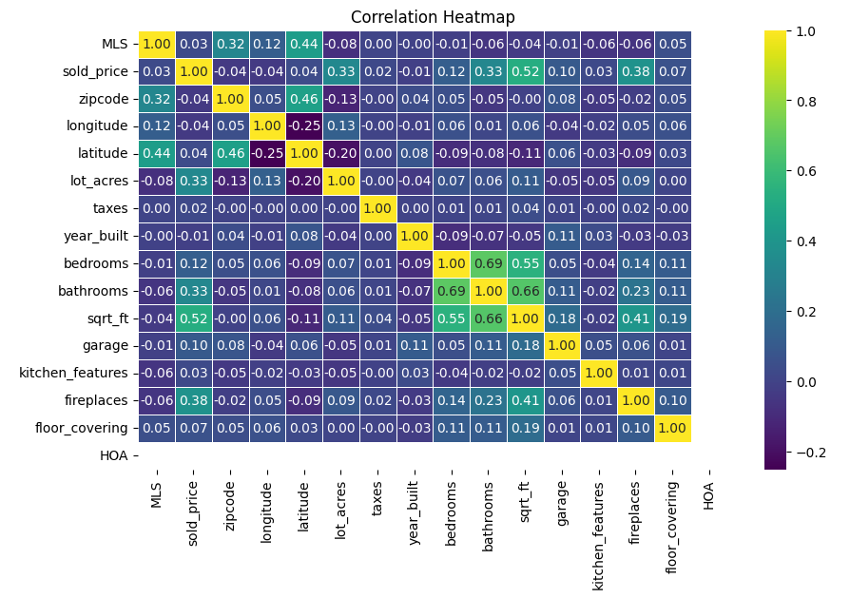

Slide 19
Summary of Exploratory Data Analysis (EDA)
Key Insights & Steps
✔ Understanding Data: Identified numerical & categorical columns ✔ Handling Missing Values: Used Mean/Median/Mode for imputation ✔ Data Distribution: Checked skewness & outliers using histograms & boxplots ✔ Correlation Analysis: Found relationships using heatmaps & pair plots ✔ Outlier Detection: Used boxplots method to detect extreme values
Visualizations Used
Histogram , Boxplot, Pairplot,Heatmap
Conclusion
The dataset has been successfully cleaned and saved as a CSV file, ensuring it is ready for further data analysis and insights.

Slide 20
Question and Answer

